Slide 1
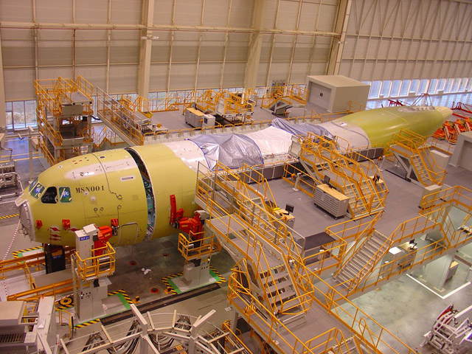
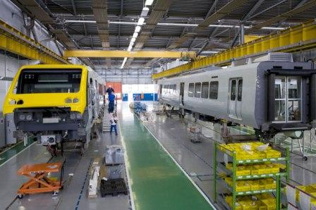
SESSION 7
Theory of Production Long-Run

Slide 2
CONTENT
Introduction
Iso-quants
Marginal rate of technical substitution
Iso-cost
Producer equilibrium
Production expansion path

Slide 3
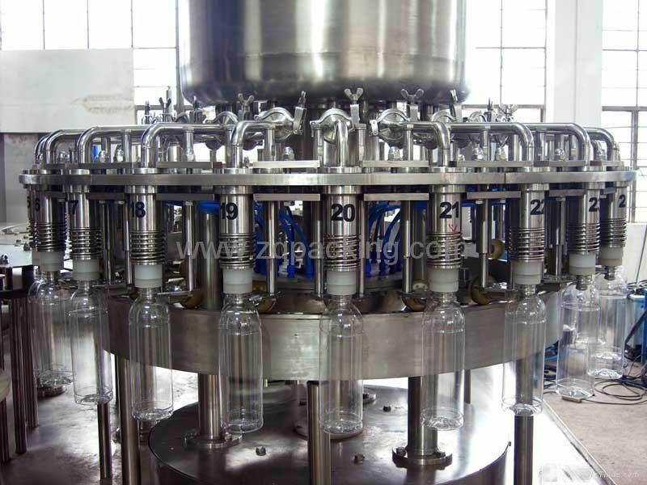
PRODUCTION WITH TWO VARIABLE INPUTS LONG-RUN ANALYSIS
In the long-run, all the inputs are variable
Long-run Production Function
Q = F (K,L) = aK + bL
Both capital (K) and labor(L) inputs are variable

Slide 4
ISO-QUANT
An Isoquant shows all different
combinations of L & K that can be used to produce a given level of output

Slide 5
ISO-QUANT
A curve showing all possible (efficient) combinations of inputs that are capable of producing a certain quantity of output
Iso quant
same quantity

Slide 6
PROPERTIES OF ISOQUANTS
Very powerful tool for non-technical exposition of production theory
Application is similar to indifference curves
Convex to the origin
Downward sloping
Do not intersect
Upper Isoquants represents higher level of output
Further from the origin represent greater output levels

Slide 7
AN ISOQUANT MAP
convex to the origin
downward sloping
do not intersect
further from the origin represents greater output levels

Slide 8
ISOQUANT MAP
Isoquant map is a set of isoquants presented on a two dimensional plain. Each isoquant shows various combinations of two inputs that can be used to produce a given level of output.

Slide 9
MARGINAL RATE OF TECHNICAL SUBSTITUTION (MRTS)
MRTS –
Marginal Rate of technical substitution indicate the rate at which factors can be substituted with out altering the level of output.
The slope of an Iso-qunat is the rate at which a producer can substitute between two inputs and maintain the same level of output
MRTS = ∆K / ∆ L OR ,
MRTS (K, L) = MP_{L} /MP_{K}

Slide 10
MARGINAL RATE OF TECHNICAL SUBSTITUTION (MRTS)

Slide 11
Factor combination | Labor | Capital | MRTS of L for K | MRTS of K for L
A | 1 | 12 | 4/1 = 4 | 1 / 4 = 0.25
B | 2 | 8
C | 3 | 5
D | 4 | 3
E | 5 | 2

Slide 12
LAW OF DIMINISHING MRTS
A property of a production function stating that as less of one input is used, increasing amounts of another input must be employed to produce the same level of output

Slide 13
PERFECT SUBSTITUTES AND COMPLEMENTARY INPUTS
Capital
Capital
2k
1L
6
4
2
6
4
2
0
4 8 12
0
2 4 6
Labour
Perfectly Substitutable Inputs- An isoquant is a straight line (so that its absolute slope or MRTS is constant) ), and downward sloping.
Complementary Inputs- An isoquant is right angled and efficient production can take place only with a specific ratio of inputs.

Slide 14
ISO-COST
Iso-cost is a line that represents combinations of inputs that will cost the producer the same amount of money.
wL + rK = C
The equation above in slope/intercept form:
K = C – w L
r r
Slope of the isocost line is –w/r
Intercept is C/r

Slide 15
AN ISO-COST LINE

Slide 16
A SHIFT IN AN ISOCOST
Iso-costs further away from the origin are associated with higher costs.
K
C⁰
C¹
L

Slide 17
A ROTATION IN AN ISO-COST
K
Changes in input prices change the slope of the isocost line, changing the relevant intercept (Intercept of the labor axis)
A new isocost line for a decrease in wages (Price of labor)
L

Slide 18
PRODUCER EQUILIBRIUM – LONG-RUN
(K*,L*) where isocost and isoquant are tangent
The slope of the isoquant is equal to the slope of the isocost line
MP_{L}/MP_{K} = w/r
MP_{L}/w = MP_{K}/r

Slide 19
PRODUCER EQUILIBRIUM
Cost minimization; Given an output constraint entails finding the isocost that is closest to the origin meeting the output constraint

Slide 20
PRODUCTION EXPANSION PATH
This joins the tangency points of isoquant curves and the isocost lines
At this equilibrium point, the ratio of marginal product of the two inputs is equal to the price ratio of the two products

Slide 21
THANK YOU….

