Slide 1
Assessment of motor neuron diseases (mnds) Hasnaa abd ellatif Muhammad Fatma Abdelhakim Mazhar Marwa Ahmed salah Mohamed Hussein hamdy Dr/ Nagwa Ibrahim Assistant professor at Cairo University code: 602

Slide 4
Types of MNDs

Slide 5
Classification
Combined UMN & LMN lesions
Amyotrophic lateral sclerosis
Pure UMN
Primary lateral sclerosis
Pure LMN
Spinal muscular atrophy (SMA) due to gene mutation
Kennedy’s disease
progressive muscular atrophy,

Slide 6
 | Pure UMNL | Pure LMNL
Cranial nerves | Pseudo bulbar palsy | True bulbar palsy
Limbs | Spastic quadriplegia | Progressive muscular atrophy

Slide 7
I. Combined UMN and LMN affection (ALS)
A means no
Myo refer to muscle
Trophic nourishment
Lateral reflect affected area in spinal cord
As this area degenerate it leads to hardening sclerosis
Most common form of MND in adults.
known as Lou Gehrig’s disease
characterized by progressive degeneration and loss of motor neurons in the spinal cord, brainstem, and brain, resulting in a variety of UMN and LMN clinical signs and symptoms.
ALS can occur at any age; however, the average age at onset is the mid-to-late 50s.
affects men slightly more than women, with an approximate ratio of 1.7:1.
regarded as a multisystem health condition.

Slide 8
There are combined signs and symptoms of LMNL and UMNL
In the upper limbs there will be weakness associated with wasting and fasciculation (LMNL) as well as hypertonia and hyperreflexia (UMNL) this is known as tonic atrophy
In lower limbs there will be weakness with signs of UMNL.
N.B
Massive loss of AHCs of spinal cord and motor nuclei of cranial nerves in brain stem result in muscle atrophy and weakness (Amyotrophic).

Slide 10
II. UMN affection
In the spinal cord (lateral sclerosis ).
In brain stem or cerebral hemisphere (pseudobulbar palsy)

Slide 11
III. LMN affection
AHCs in spinal cord progressive muscular atrophy.
In brain stem cranial nerves nuclei true bulbar palsy

Slide 13
[2]
Etiology
The exact causes are unclear.
The current consensus on the pathogenesis of MND is that it results from a complex interaction between genetics, environment and sedentary life .
Approximately 10-15% of MND cases have a positive family history (familial MND), while the majority do not (sporadic MND), we now know that around 15% of people with apparently sporadic MND carry a pathogenic mutation in an MND-associated gene.
A meta-analysis of environmental risks found significant associations with exposure to heavy metals, pesticides, solvents or previous head injury.
Oxidative stress theory: Distribution of cell detoxification mechanisms >> oxidative stress on neurons >> neuronal degeneration.
Loss of certain neurotrophic factors: These factors are responsible for maintenance and survival of neurons.

Slide 14
[3]
Clinical Features
MND is characterized by a painless, progressive paralysis.
It usually begins in an asymmetrical fashion, affecting a focal muscle group, before spreading to involve other areas.
The onset of weakness in the limbs often affects the distal muscles initially.
Weakness of upper limbs manifests as difficulties with fine motor control.
Weakness of the lower limbs often manifests as foot drop, difficulties with walking and falls.
Symptoms that accompany limb weakness are muscle twitching (fasciculations), cramps and stiffness. Bulbar weakness causes speech difficulties (dysarthria), followed by difficulties in swallowing (dysphagia). Dysphagia can result in drooling, choking and chest infections.
Neck weakness can cause a head drop. Respiratory muscle weakness usually occurs later in the disease process, and initially manifests as nocturnal hypercapnia, with poor sleep, morning headaches.
There is usually relative sparing of the occular and pelvic floor muscles, and lack of autonomic and sensory features.

Slide 15
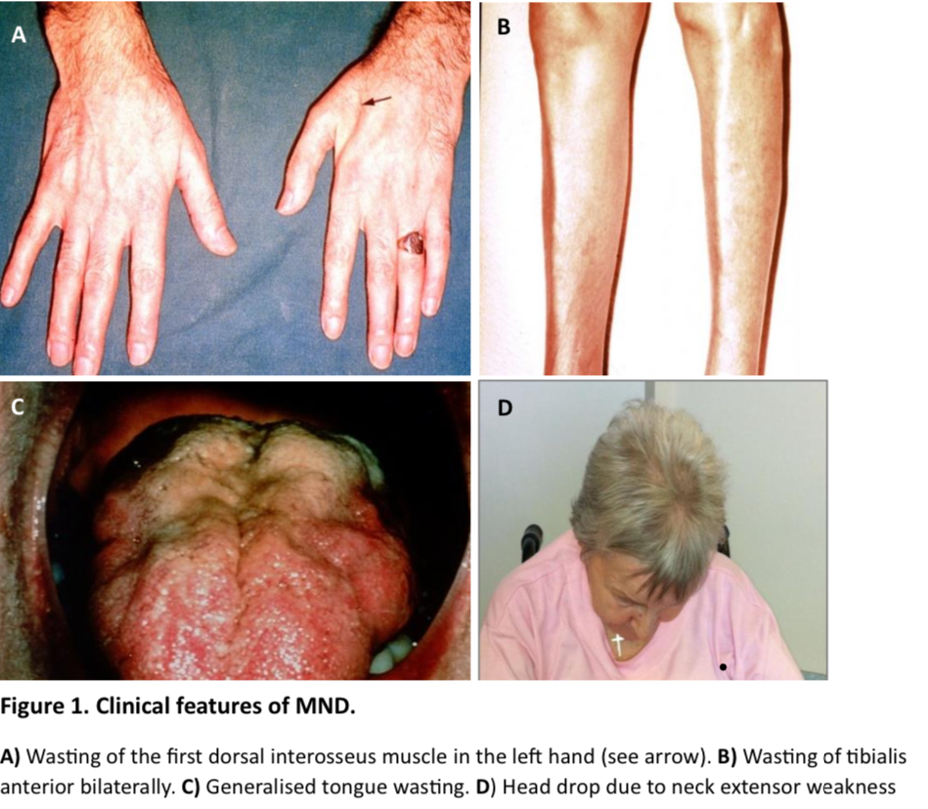
[4]
Key examination findings
Features of lower motor neuron (LMN) pathology such as wasting and fasciculations are evident on inspection. Fasciculations are most often found across the large proximal muscles such as deltoid and quadriceps.
Wasting in the hands particularly affects the first dorsal interosseus muscle, other intrinsic muscles of the hands and the thenar eminence. In the lower limbs, wasting commonly affects the tibialis anterior muscle especially in the context of a foot drop.
Examination of the tongue often reveals wasting fasciculations and weakness.
Neck extension weakness may present as a head drop.
True bulbar palsy maybe present.

Slide 16
[5]
Features of upper motor neuron pathology as abnormalities in tone (hypertonia/spasticity) and deep tendon reflexes (hyperreflexia) might also be found.
Pseudo bulbar palsy is a hallmark of UMN pathology.

Slide 17
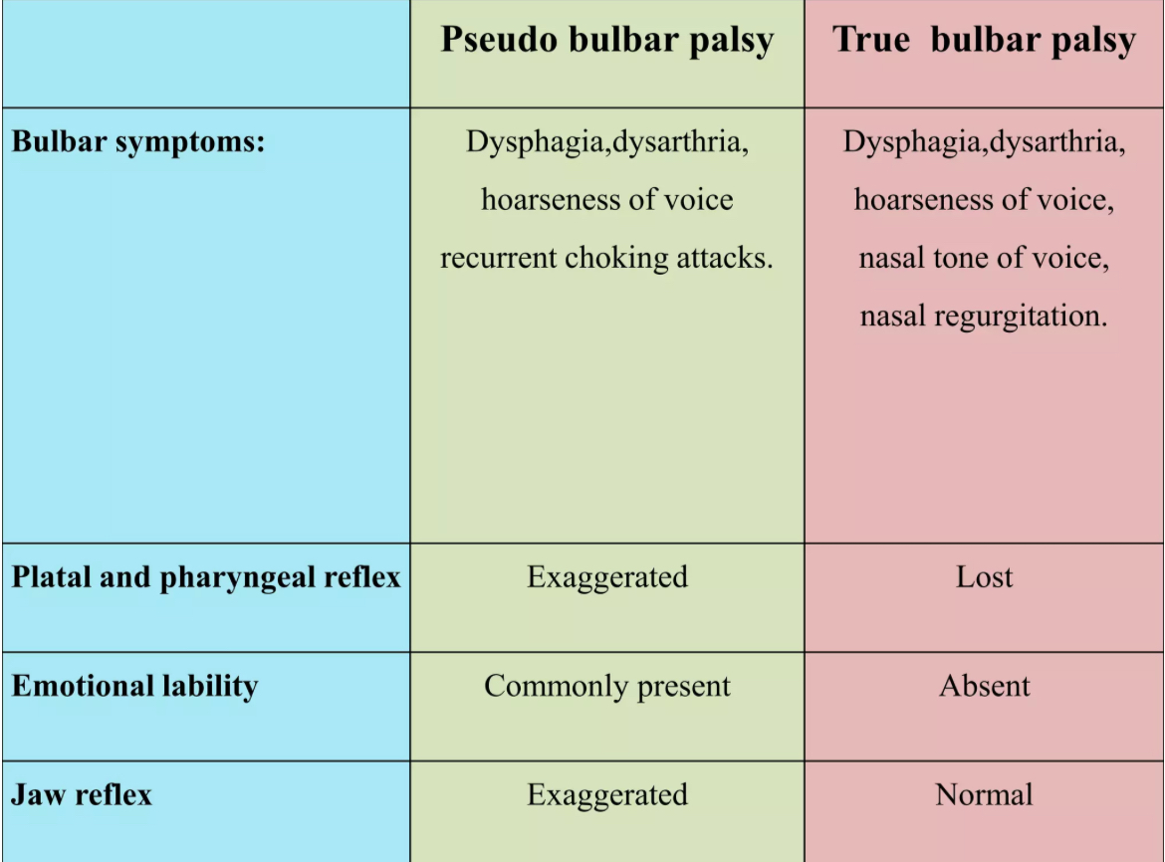
[6]

Slide 18
[7]
Combined M.N.D
Amyotrophic lateral scelerosis
Gradual onset and progressive course.
Cranial nerves examination :
Affection of all cranial nerves except oculomotor nerve
Pseudobulbar palsy (Bulbar onset ALS is more common in older females with a male:female ratio 2:3)

Slide 19
[7]
Amyotrophic lateral scelerosis
Gradual onset and progressive course.
Cranial nerves examination :
Affection of all cranial nerves except oculomotor nerve
Pseudobulbar palsy (Bulbar onset ALS is more common in older females with a male:female ratio 2:3)

Slide 20
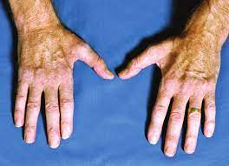
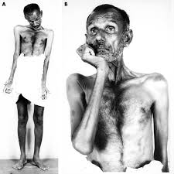
Motor system examination:
Weakness of both upper and lower limbs
Usually starts at upper limb characteristically weakness at the first dorsal interosseus
Weakness of neck muscles (chin drop – patient holds his head with his hands)

Slide 21
Tonic atrophy
Combined features of U.M.N.L L.M.N.L
L.M.N Symptoms : weakness dorsal > proximal muscles
Fasciculations of tongue and bulky muscles
u.m.n symptoms: positive Babinski sign and hyper reflexia
Sparing of first 3 sacral spinal nerves meaning preservation of bowel and bladder functions
Sensory examination :
Normal
Emotional lability may also occur.

Slide 22
Diagnosis
Electrophysiological studies: nerve conduction studies are required to exclude motor neuropathy and to provide evidence of chronic denervation
Neuroimaging studies: to exclude conditions which may cause U.M.N and L.M.N signs that may stimulate ALS e.g. focal quadriparesis due to cervical cause.

Slide 23
Pure U.M.N involvement
Primary lateral sclerosis
Hereditary spastic paraplegia

Slide 24
Primary lateral sclerosis
No family history of PLS
Gradual progression of the disease
Duration: 3 years or more.
Clinical findings limited to those usually associated with corticospinal dysfunction
Symmetrical distribution, ultimately developing severe spastic spinobulbar paresis
Normal bladder function
Absent or very prolonged latency on cortical motor evoked responses in the presence of normal peripheral stimulus-evoked maximum compound muscle action potentials.

Slide 25
PLS is a relatively rare condition (affecting 1–3% of those with MND) and presents with upper motor neuron involvement only.
Diagnosis is often delayed to exclude potential other causes.
clinically those with PLS have only upper motor neuron signs without focal muscle atrophy or visible fasciculations and normal electromyography of limbs and bulbar muscles
The condition can progress to ALS, but if no LMN signs are seen after 4 years prognosis is good with life expectancy comparable to normal, although this is rare.

Slide 26
Laboratory
Normal serum chemistries, which include normal vitamin B12 levels.
Negative serologic tests for syphilis; in endemic areas, negative Lyme and human T-cell lymphocytotrophic virus-1 (HTLV-1) serologies.
Normal cerebrospinal fluid parameters, including absence of oligoclonal bands.
Absent denervation potentials on EMG or at most, occasional fibrillation and increased insertional activity in a few muscles (late and minor).
Absence of compressive lesions of cervical spine or foramen magnum (spinal MRI scanning)
Absence of high-signal lesions on MRI similar to those seen in multiple sclerosis.

Slide 27
Hereditary spastic paraplegia
Progressive
Hereditary
Motor examination:
Weakness most commonly occurs in the lower limbs, but mild upper limb weakness may also occur.
The upper limbs may also experience poor coordination and hyperreflexia, although a positive Babinski sign may not be elicited in the majority of individuals with HSP
Sensory examination:
Decreased pallesthesia and proprioception are common

Slide 28
Autonomic examination:
Urinary symptoms, such as incontinence, are present in up to 50% of individuals
Gait examination
walking on the tip of toes with ankles inverted
reduced step length
increased step width
reduced range of motion in the knee with increased trunk range of motion in all plane
high foot arch

Slide 29
Manifestation | Complicated HSP | Uncomplicated HSP
Motor | L.L > U.L weakness and spasticity U.L poor coordination and hyperreflexia Muscular atrophy Extrapyramidal disturbance | Lower limb spasticity and weakness No U.L involvement
Sensory | Decreased vibration sense (pallesethia) And proprioception | Mild affection to L.L vibration sense
Autonomic | Urinary disturbances | Urinary disturbances
others | Ataxia Seizures intellectual disability Dementia Peripheral neuropathy | No speech , swallowing involvement

Slide 30
Clinically Relevant Anatomy
Severe degeneration of the corticospinal tract, and a usually less severe degeneration of the posterior column-medial lemniscus pathway.
The corticospinal tract is the major descending motor pathway that terminates on motor neurons and interneurons in the ventral horn of the spinal cord and ultimately controls movement in the limbs and trunk.
The posterior column-medial lemniscus pathway ascends from the periphery to the primary somatosensory cortex on the post-central gyrus and conveys sensory information of fine, discriminative touch, proprioception and vibration sense.
HSP patients experience a marked reduction in the area and axonal density of both the corticospinal and posterior column-medial lemniscus pathways.which accounts for the presentation of lower limb spasticity, followed by generally less severe weakness and reduced vibration sense.

Slide 31
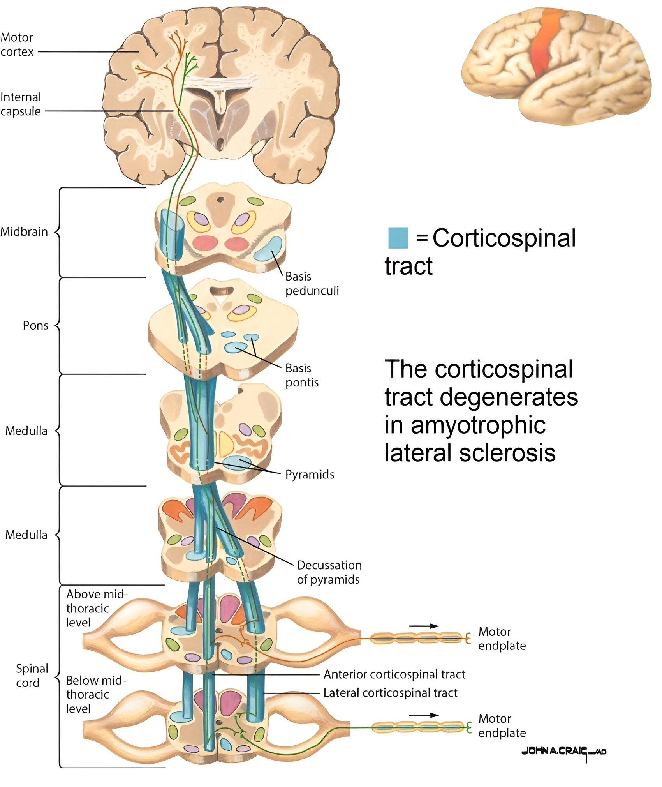

Slide 32
Laboratory
Detailed investigation of family history
A thorough physical assessment investigating the clinical features of HSP and potential genetic testing or subjective family history should be implemented to strengthen the diagnosis.

Slide 33
Pure L.M.N involvement (spinal muscular atrophy S.M.A)
Acute infantile S.M.A (werding Hoffmann syndrome)
Bulbo S.M.A (Kennedy's syndrome)
Chronic childhood S.M.A (kugelberg welander syndrome)
Distal S.M.A

Slide 34
S.M.A is classified based on the age at which symptoms first occur as well as the level of muscle activation attained or expected to be attained.
SMA symptoms range in severity but often include:
hypotonia
muscle weakness (proximal muscles greater than distal muscles and lower extremity than upper extremity)
bone or joint issues
difficulty swallowing
and/or difficulty breathing

Slide 35
 | TYPE 1 (MOST SEVERE)(Werdnig-Hoffmann disease of acute infantile SMA) | TYPE 2 | TYPE 3 (Kugelberg-Welander syndrome or juvenile SMA) | TYPE 4
AGE OF ONSET | First 6 months | 6-18 months | 18 months or older | Adulthood (after 21 years)
SYMPTOMS | Reduce muscle tone Contractures Reflexes absent Swallowing,feeding difficulty | Can sit Unable to stand/walk without support Respiratory difficulties | Walk independently Difficulty in running, stair climbing Scoliosis | Mild to moderate leg weakness
LIFE EXPENTANCY | Die before 2 years | Adolescence or young adulthood | Normal lifespan (with regular physical rehabilitations) | Normal lifespan(with little physical training)

Slide 36
laboratory
Diagnosis generally starts with genetic testing to determine whether or not the SMN1 gene is absent.
Genetic testing has been found to have a 95% sensitivity (test shows the absence of SMN1 the gene when it is truly absent) and an almost 100% specificity (test shows the presence of SMN the gene when it is truly present).
If genetic testing does return a result consistent with clinical signs and symptoms, additional testing in the form of electrocardiography, a muscle biopsy, a nerve conduction velocity study, or blood tests can be performed.

Slide 38
[7]
Differential Diagnosis
[A]- MND vs Root compression
Root Compression | MND
• Weakness of hand due to compression of nerve mainly C8 • With Sensory affection | • Weakness of hand due to affection of lower cervical region • No Sensory affection
[B]- MND, MS and Traumatic SCI
Traumatic SCI | MS | MND
affected | affected | preserved | Sensation:
affected | affected | preserved | Bladder Function:
preserved | affected | affected | Cranial Nerve:
Motor function is affected | Has no selectivity, affect motor and sensory Cranial n, mainly Optic [Optic Neuritis] | Has selectivity with only motor nuclei of Cranial n, and mainly Bulbar N.

Slide 39
References
1. Fulk, G.D. and Chui, K.K. (2024) O’Sullivan & Schmitz’s physical rehabilitation. 8th ed. Philadelphia, PA, United States of America: F. A. Davis Company.
Lazaro, R. T., Reina-Guerra, S. G., & Quiben, M. (Eds.). (2019). Umphred's Neurological Rehabilitation-E-Book: Umphred's Neurological Rehabilitation-E-Book. Elsevier Health Sciences.
Tiryaki, E., & Horak, H. A. (2014). ALS and other motor neuron diseases. CONTINUUM: Lifelong Learning in Neurology, 20(5), 1185-1207.
singer MA, Statland JM, Wolfe GI, Barohn RJ. Primary lateral sclerosis. Muscle & Nerve: Official Journal of the American Association of Electrodiagnostic Medicine. 2007 Mar;35(3):291-302.
Pringle CE, Hudson AJ, Munoz DG, Kiernan JA, Brown WF, Ebers GC. Primary lateral sclerosis: clinical features, neuropathology and diagnostic criteria. Brain. 1992 Apr 1;115(2):495-520.
Wais V, Rosenbohm A, Petri S, Kollewe K, Hermann A, Storch A, Hanisch F, Zierz S, Nagel G, Kassubek J, Weydt P. The concept and diagnostic criteria of primary lateral sclerosis. Acta Neurologica Scandinavica. 2017 Sep;136(3):204-11.
Ingrid F, Eduardo RP, Alberto M, Marcondes FJ, Helio AGT. Hereditary spastic paraplegia from 1880 to 2017: an historical review. Arq Neuropsiquiatr 2017;75(11):813-818. doi.org/10.1590/0004-282x20170160

Slide 40
References
8. Fink KJ. Hereditary spastic paraplegia overview. GeneReviews 2014. Available from: https://www.ncbi.nlm.nih.gov/books/NBK1509/
9. Engmann B, Wagner A, Steinberg H. Adolf von strümpell: A key yet neglected protagonist of neurology. Journal of Neurology 2012; 259(10):2211-2220. DOI 10.1007/s00415-012-6486-6
10. Depienne C, Stevanin G, Brice A, Durr A. Hereditary spastic paraplegias: an update. Current Opinion in Neurology 2007; 20(6):674-680. DOI: 10.1097/WCO.0b013e3282f190ba
11. Al Masri O. An essay on the human corticospinal tract: history, development, anatomy, and connections. Neuroanatomy. 2011;10:1-4.
12. Davidoff RA. The dorsal columns. Neurology. 1989 Oct 1;39(10):1377-1385.
13. DeLuca GC, Ebers GC, Esiri MM. The extent of axonal loss in the long tracts in hereditary spastic paraplegia. Neuropathology & Applied Neurobiology 2004;30(6):576-584. doi.org/10.1111/j.1365-2990.2004.00587.x
14. Reid E. Pure hereditary spastic paraplegia. Journal of Medical Genetics 1997;34:499-503. PMID:9192272
15. Rubin M. Hereditary Spastic Paraparesis - Brain, Spinal Cord, and Nerve Disorders N.D. Retrieved April 29, 2018, from https://www.merckmanuals.com/en-ca/home/brain,-spinal-cord,-and-nerve-disorders/spinal-cord-disorders/hereditary-spastic-paraparesis
16. Serrao M, Rinaldi M, Ranavolo A, Lacquaniti F, Martino G, Leonardi L, Pierelli F. Gait Patterns in Patients with Hereditary Spastic Paraparesis. PLoS ONE 2016;11(10):1-16. DOI 10.1371/journal.pone.0164623

Slide 41
References
17. Darras BT, Markowitz JA, Monani UR, De Vivo DC. Spinal muscular atrophies (2015) Neuromuscular Disorders of Infancy. Childhood, and Adolescence: A Clinician’s Approach.:117-45.
18. Umphrend D, Lazaro R, Roller M, Burton G. Umphrend's Neurological Rehabilitation. Sixth Edition. St. Louis, MO, USA. Elsevier Mosby, 2013.
19. National Health Service. Spinal muscular atrophy. Available from https://www.nhs.uk/conditions/spinal-muscular-atrophy-sma/ Last accessed 4/24/2023.
20. National Institute of Neurological Disorders and Stroke. Spinal Muscle Atrophy. Available from https://www.ninds.nih.gov/health-information/disorders/spinal-muscular-atrophy (accessed 4/26/2023).

