Slide 1
POSTPARTUM HAEMORRHAGE
DR. ISAAC O. KORANTENG
BSc., MB., ChB., FWACS

Slide 2
PRIMARY POSTPARTUM HAEMORRHAGE
Blood loss per vaginum of more than 500 ml within the first 24 hours after vaginal delivery OR
Blood loss per vaginum of more than 1000 ml within the first 24 hours after C/S OR
Any bleeding per vaginum within the first 24 hours after delivery resulting in hypovolemia or otherwise causing a woman to become symptomatic due to the blood loss.

Slide 3
CAUSES OF PRIMARY PPH
TONE – Uterine atony
TRAUMA – Tears in the genital tract
TISSUE – Retained placenta or pieces of placenta
THROMBIN – clotting abnormalities

Slide 4
UTERINE ATONY
Uterine atony is a loss of tone in the uterine musculature. Normally, contraction of the uterine muscle compresses the vessels and reduces flow. Thus, lack of uterine muscle contraction can cause an acute hemorrhage.
Clinically, ≥ 80% of postpartum hemorrhages are due to uterine atony.

Slide 5
RISK FACTORS FOR UTERINE ATONY
Factors during the pregnancy, which resulted in an abnormally large uterus
Factors during the pregnancy, which results in inability of the uterus to contract well

Slide 6
ABNORMALLY LARGE UTERUS
Big Baby
Multiple pregnancy
Polyhydramnios
Fetal abnormalities e.g. severe hydrocephalus

Slide 7
INABILITY OF THE UTERUS TO CONTRACT WELL
Grande multiparity
Uterine fibroids
Retained placental cotyledons
Prolonged labour
Anaesthesia - Halogenated anesthetics
Abruptio placentae
Placenta Praevia
Chorioamnionities
Drugs – Magnesium sulphate

Slide 8
MANAGEMENT
Call for help
Resuscitation - adequate blood volume replacement
Treatment

Slide 9
INITIAL RESUSCITATION
Two wide bore canulae
Take blood for grouping and cross matching and for FBC and Clotting Profile
Rapid infusion of IV fluids
Passage of urethral catheter

Slide 10
Treatment
The first step in management of uterine atony is uterine massage
The next step is pharmacological therapies, the first of which is oxytocin
The next step in the pharmacological management is the use of ergometrine & Misoprostol (Cytotec).
Surgery if the above measures fail

Slide 11
PHARMACOLOGICAL THERAPIES
Initial pharmacological therapy - Intravenous infusion of 20 units oxytocin in 500 ml of normal saline
The next pharmacological management is the use of ergometrine 0.5 mg IV and IM & Misoprostol (Cytotec) 600-800mcg rectally
Ergometrine is contraindicated if the BP is high

Slide 12
FAILURE OF MEDICAL MANAGEMENT
Examination under anaesthesia (EUA)
Retained placenta – Manual removal
Genital tract lacerations - Suture
Retained placenta tissue – E.O.U
Clotting Abnormality – FFP, Platelet conc. etc
Failure of medical Mg. of Atony – Surgical Mg.
Surgical management

Slide 13
SURGICAL MANAGEMENT OF PPH
Tamponade (balloon) or uterine packing
Apply compression sutures
Systematic pelvic de-vascularisation - Uterine artery ligation, The tubal branches of both ovarian arteries, Internal iliac artery ligation
Interventional radiologist—if appropriate, ‘uterine artery embolization
Subtotal or total abdominal hysterectomy

Slide 14
Balloon Tamponades
Mechanism of action:
The balloon inserted in the uterus and inflated with saline exerts pressure on the uterine vessels to stop bleeding
A positive tamponade test can occur within 5 to 15 minutes
Very effective (≥85%)
Easy to use
Is being effectively used in low resource settings
Safer alternative to uterine packing
Source: Georgiou C. Balloon tamponade in the management of postpartum haemorrhage: a review. BJOG 2009;116:748-757.

Slide 15
THE CONDOM TAMPONADE
UTERUS
Water/NS
Inflate Condom with water till no further bleeding is occuring (usually about 300-500 mls )
syringe
Condom
Giving set
OR
String
Foleys Catheter
Clean
water
Apply clamp to keep water within
Condom after inflation

Slide 16
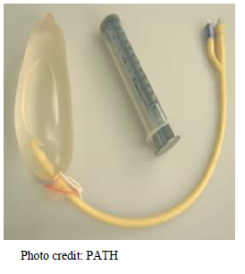
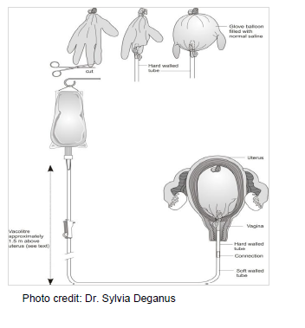
Innovative Uterine Balloon Tamponade Devices
Using gloves
Condom Balloon Tamponade

Slide 17
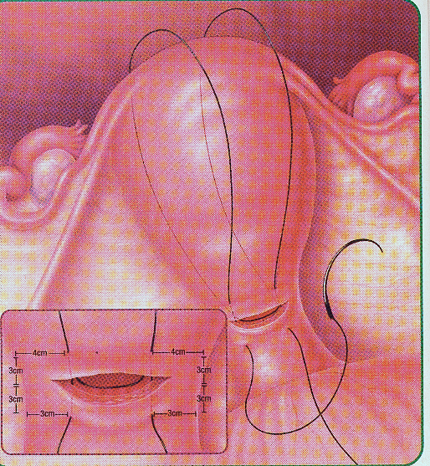
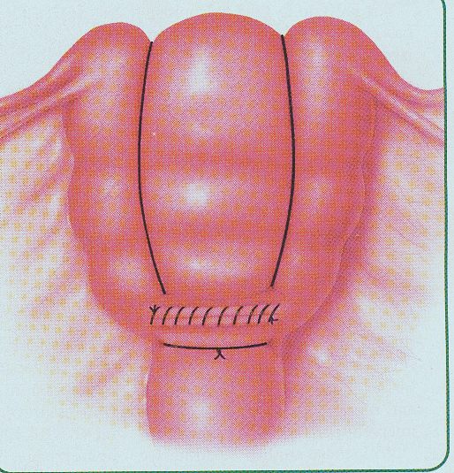
Surgery: Compression Sutures
E.g. B-Lynch Suture

Slide 18
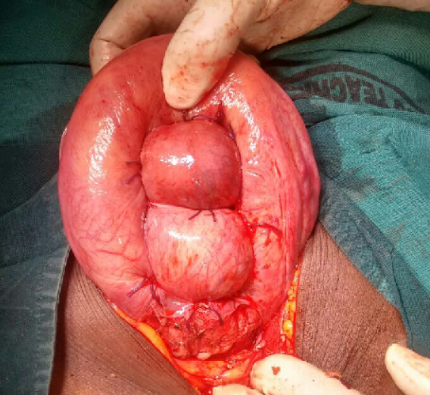

Slide 19
WHAT CAN BE DONE TO REDUCE THE RISK OF PPH
In patients who are at high risk of postpartum haemorrhage (e.g. multiple pregnancy, polyhydramnios or grand multiparity) the following should be done:
An intravenous infusion should be started during the active phase of the first stage of labour.
Twenty units of oxytocin in 500 ml of normal saline should be given by rapid infusion after the placenta has been delivered.
Make sure that the uterus is well contracted during the first hour after the delivery of the placenta and make sure that the patient empties her bladder frequently.

Slide 20


