Slide 1
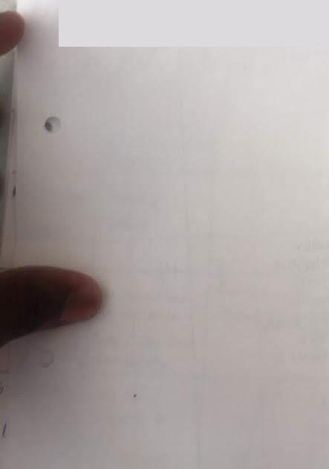
Aci-itrv&meNns
I.
ie_{h}re_{c}i_{tif}d
^{1,}itte hey
fy re_{e}k!,
Prof (-I- 1) t Mein "je sm—_{e}„,
Pratt", Gar-dinar-a,
3 • &M⁻er iLdecoon 4⁻4
cur k•ritc'--f cit P^{r)}, Ire 7 e_eii nA. 0 r•t‘ ece •
()_{I}
0 tjr14, OJItCOVICt 011 _{ra} ,fr_{ud} theof
at teat( «⁴⁴ VY•⁽⁴ •
Przfroteci 1₀₂ ca in A fri_{c}ecz
..se -5 P

